Slide 1

Teaching Resources and Instructors’ Guidelines
Chapter 14: Capturing social value

Slide 2
Chapter 14: Capturing social value
In the following PowerPoint slides you will find the key headings from CHAPTER 14 together with the main illustrations, tables, etc.
There are also slides summarizing the key messages in bullet-point fashion, and a wide range of activities which you can use to help students explore around these themes.
Finally there are some reflection questions which can be used as the basis for discussion or assignments

Slide 3
Learning objectives
By the end of this chapter you will develop
an understanding of:
Social entrepreneurship and social innovation.
Social innovation as an organized and disciplined process rather than well-meaning but unfocused intervention.
The difficulties in managing what is just as much an uncertain and risky process as ‘conventional’ economically motivated innovation.
The different ways in which innovation can contribute to improved sustainability and the management challenges involved.
The concept of ‘responsible innovation’.

Slide 4

Core themes and material from the book

Slide 5
Social innovation
Using innovation to create social value
Innovation for the greater good

Slide 6
Why social innovation?
‘Social entrepreneurs are not content just to give a fish or teach how to fish. They will not rest until they have revolutionized the fishing industry’.
— Bill Drayton, CEO, chair and founder of Ashoka, a global non-profit organization devoted to developing the profession of social entrepreneurship

Slide 7
Characteristics of social innovations
Social innovations are usually new combinations or hybrids of existing elements, rather than being wholly new in themselves.
Implementing them involves cutting across organizational, sectoral or disciplinary boundaries.

Slide 8
Characteristics of social innovations
They create new social relationships between previously separate individuals and groups, contributing to the diffusion and embedding of the innovation, and increasing potential for further innovations.
Social innovation is also seen as building on the inherent capacities of individuals and communities, which makes the notion of open innovation especially relevant.

Slide 9
Social innovators….
Motives and aims – less concerned with independence and wealth, and more concerned with social means and ends
Timeframe – less emphasis on short-term growth and longer-term harvesting of the venture, and more concern on long-term change and enduring heritage
Resources – less reliance on the firm and management team to execute the venture, and greater reliance on a network of stakeholders and resources to develop and deliver change

Slide 10
Challenges in social innovation
Challenge area
Search | Recognising and connecting opportunity rather than focusing on urgent need areas. Need passion, vision and ability to bridge different worlds
Selection | Need to build networks of support across multiple stakeholders – but may also need to manage conflicts of different aims and interests amongst those stakeholders
Implementation | Need for agility and ingenuity to access resources
Capture value | Challenge of moving beyond pilots – need for complementary assets and partnerships
Strategy | Need to balance passion with realism in reconciling aims of different stakeholders
Organization | Moving to scale will require extensive external networking and different internal organization, risk of conflicts of values
Context | ‘Lumpy’ and irregular funding, risk aversion amongst donors

Slide 11
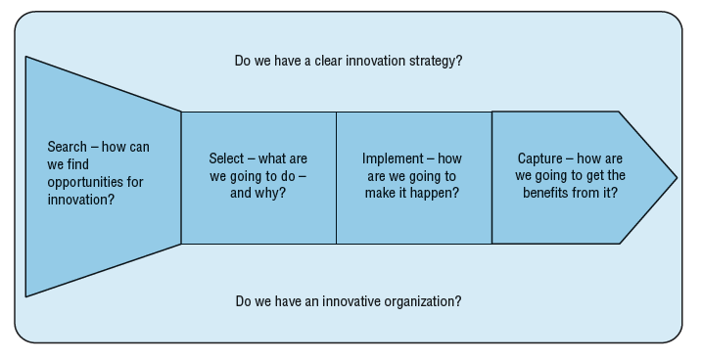
Mapping social innovation to core model

Slide 12
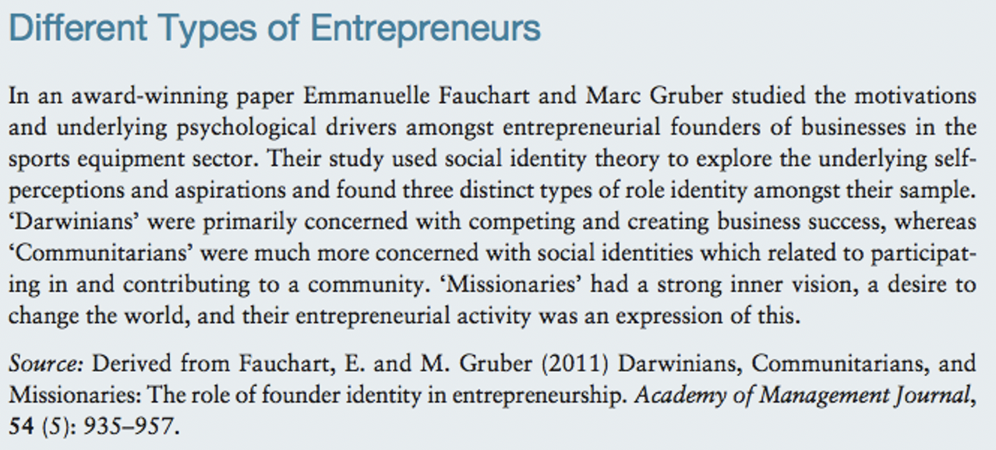
Social identity matters

Slide 13
Corporate social responsibility
social innovation as securing a ‘licence to operate’
• social innovation as aligning values
• social innovation as a learning laboratory

Slide 14

Sustainability

Slide 15
The threat….
The WWF reports regularly on the challenges to sustainability and their data suggests that we are consuming resources equivalent to more than One Planet….
http://wwf.panda.org/what_we_do/how_we_work/conservation/one_planet_living/

Slide 16
… and the opportunity
Some data on reports suggesting big market and growth potential
PricewaterhouseCoopers report estimate significant market potential in the provision of green goods and services, as high as 3% of global GDP
http://businesstoday.intoday.in/story/the-market-potential-for-ecofriendly-products-and-services-is-over-$40-bn/1/8411.html
http://www.lohas.com/lohas-marketplace
http://stoppress.co.nz/blog/2010/08/survey-shows-huge-potential-for-eco-friendly-growth-in-new-zealand

Slide 17
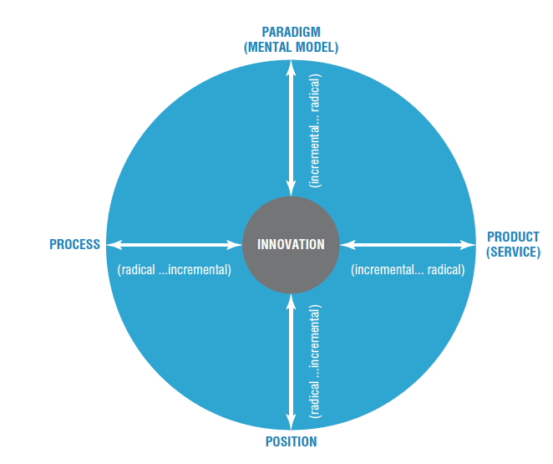
Scope for innovation

Slide 18
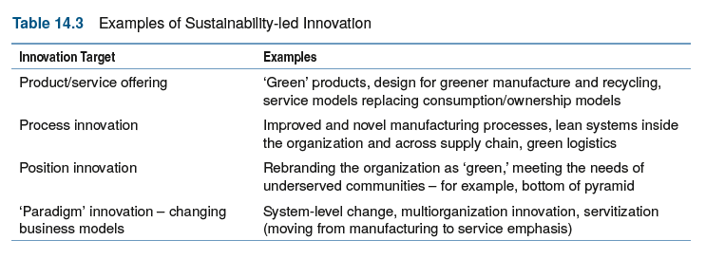
Options in sustainability-led innovation

Slide 19
The NBS framework
The Network for Business Sustainability regularly reports on sustainability-led innovation
This is a link to their website and a downloadable report describing a major research study and framework for sustainability-led innovation

Slide 20
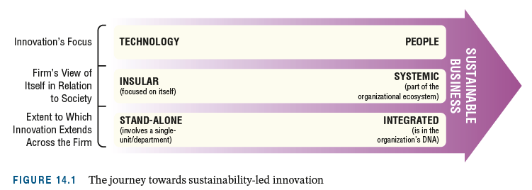
Overview of NBS model

Slide 21
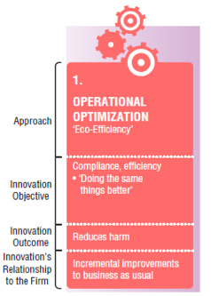
Level 1: Operational optimization

Slide 22
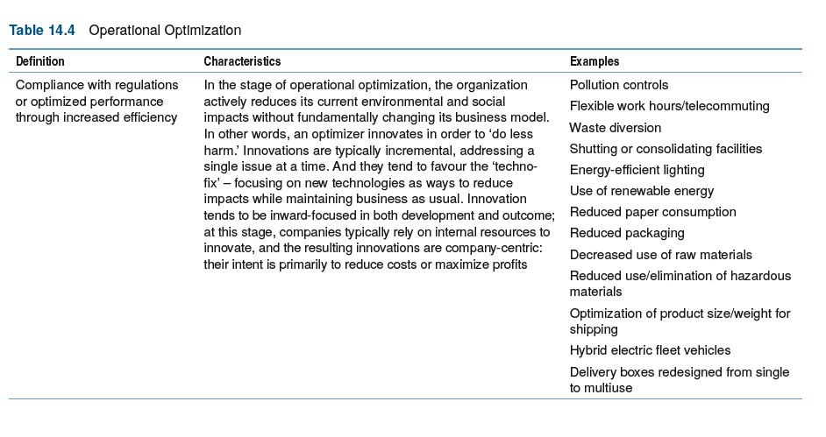
Examples of operational optimization

Slide 23
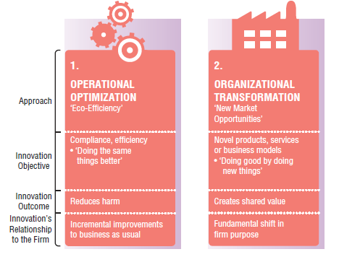
Level 2: Organizational transformation

Slide 24
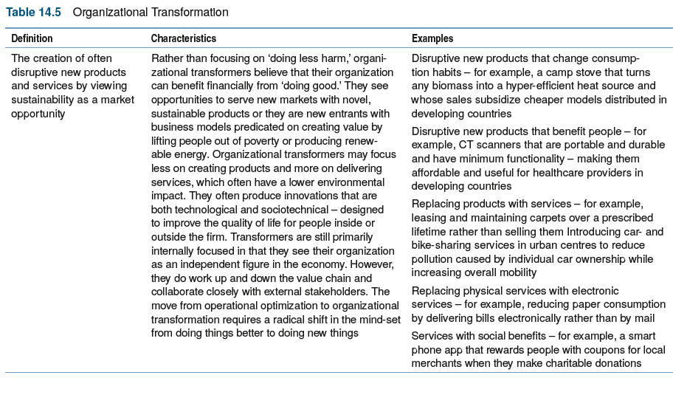
Examples of organizational transformation

Slide 25
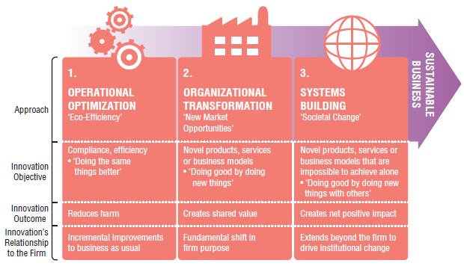
Level 3: Systems change

Slide 26
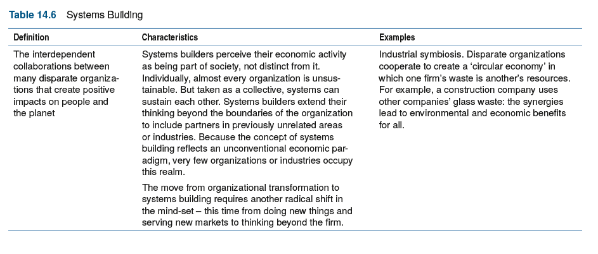
Examples of systems change

Slide 27
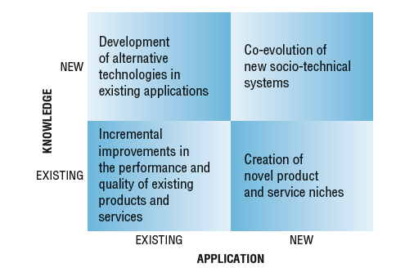
A typology of sustainable innovations

Slide 28
Mapping sustainability to the innovation process

Slide 29
Challenges in managing sustainability-led innovation
Stage | Challenge
Search | Peripheral vision, searching in unfamiliar fields Reframing Finding, forming and performing in novel networks
Select | Resource allocation under high uncertainty Cognitive dissonance Not-invented-here
Implement | Mobilizing new internal skills, structures, etc.
Capture value | Crossing the chasm and the diffusion process
Innovation strategy | Need for clear roadmap for the future which embeds sustainability vision New paradigm based on people, profit, planet types of model

Slide 30
Responsible innovation
“Responsible innovation means taking care of the future through collective stewardship of science and innovation in the present.”
Four key dimensions:
  Anticipation
  Inclusiveness
  Reflexivity
  Responsiveness

Slide 31
Summary
Social innovation is about creating value and making change happen in a socially valuable direction.
Although often driven by passionate individual entrepreneurs social innovation is also an increasingly important component of mainstream business as organizations realize that they only secure a licence to operate if they can demonstrate some concern for the wider communities in which they are located.
There is also extensive social innovation within the public and ‘third’ sector.
Social innovation is particularly challenging because of the need to identify and engage a wide range of stakeholders – and understand and meet their very diverse expectations.

Slide 32
Summary
Sustainability is becoming a key factor in innovation, representing both a significant threat and a source of opportunity.
Sustainability-led innovation (SLI) involves changes across the ‘innovation space’ – in products/services, in processes, in positions and in paradigms.
SLI poses challenges across the innovation process model – how we search, select and implement. In particular working at the higher levels of the model, towards organizational transformation and systems building – will require developing new routines.

Slide 33
Summary
There is growing pressure on organizations to demonstrate that their approach involves a degree of ‘responsible innovation’.
Four key dimensions:
  Anticipation
  Inclusiveness
  Reflexivity
  Responsiveness

Slide 34

Videos
There are several videos which can help explore and present the key themes of the chapter:
Notes:
Short videos

Slide 35
Videos
Interview with Simon Tucker of Young Foundation talking about how to support social innovation
Suzana Moreira of moWoza, talking about her social start-up in southern Africa
Melissa Clark-Reynolds talking about MiniMonos her start-up in the sustainability space
Mike Pitts talking about challenges in sustainable innovation
Pedro Oliveira talking about Patient Innovation, a social innovation platform for healthcare
Short video on responsible innovation in healthcare
Let’sLocalise, a platform for community engagement

Slide 36
Videos
Ray Anderson , founder of Interface ( a major floor coverings company) increased sales and doubled profits while turning the traditional “take / make / waste” industrial system on its head. He was passionate about sustainability and pioneered a wave of innovation which still drives the business.
In this TED talk he sets out his ideas about building a successful business driven by sustainable innovation
https://www.ted.com/talks/ray_anderson_the_business_logic_of_sustainability?language=en

Slide 37
Podcasts and blogs
There are several podcasts here and blogs here which cover themes raised in this chapter. In particular:
Peanut-powered innovation, looking at the innovation legacy of Washington Carver
Why bother with user innovation?

Slide 38
Cases
There are several case studies which highlight themes in this chapter; you can find them here. In particular:
Luminaid
Eastville Community Shop
Aravind
NHL
Lifespring
Aquapax
Better Place
Espresso Mushroon
Humanitarian innovation
Let’sLocalise
Lifeline Energy
Minimonos
Mowoza
Natura
Samasource
Philips journey to sustainability

Slide 39
Cases
Another good resource is the NESTA website with reports, cases, tools and other information around social innovation.
http://www.nesta.org.uk/

Slide 40
Activities
There are several activities designed to help explore themes raised in this chapter – you can find a full list here. In particular:

Slide 41
Activities
Look at the Lifeline Energy case study
How could you reconcile the social agenda – make radios freely available – with the commercial challenges of running a business? What problems do you think Freeplay/Lifeline Energy face in trying to sustain the business?

Slide 42
Read the case study of Eastville Community Shop
and then explore it using this activity
Activities

Slide 43
Activity: Sustainability
Ask students to choose an organization and explore the sustainability challenges which it faces.
What will they be forced to think about as a result of growing regulation?
Where might there be opportunities to cut costs or grow the business?
What might their strategy look like for sustainability-led innovation?
What challenges might implementing it pose?

Slide 44
Activity: Exploring sustainability-led innovation
Ask students to choose an organization to focus on and then, using the 4Ps framework, explore and identify opportunities for sustainability-led innovation.
Prepare a short presentation highlighting the key ‘do better’ (incremental innovation) and ‘do different’ (radical innovation) options. What might the challenges be in implementing such a strategy?

Slide 45
Activities
‘Dragon’s Den’ is a popular BBC TV programme in which successful entrepreneurs and venture capitalists listen to would-be entrepreneurs pitch for money to fund their business ideas. Appoint several team members to be the (tough, hard-nosed and business-minded ‘dragons’) and the remainder of the group should prepare ‘pitches’ setting out how they would carry through a social innovation.
Groups should spend a few minutes brainstorming around key areas of social need – and at the same time the Dragons should think of the key questions to ask of any entrepreneur to assess whether and how far they have thought through their business idea.

Slide 46
Activities
Identify an area of social need and develop some ideas for possible innovative solutions which might help deal with this challenge. Then think about how you would turn this into a business plan and convince other people to back your idea or help you take it forward.
Think about the likely questions they would ask and how you would make a strong case to convince the more sceptical members of your audience.
Write your ideas up as an outline business plan.

Slide 47
Activities
Read the ‘Better Place’ case study (on the Portal) and carry out additional research on the project. Prepare an analysis which positions this innovation on the NBS framework and discuss why you think it failed. What might the team have done differently and what lessons can you draw out for successful management of similar ventures in the future?

Slide 48
Tools
This is a link to the core framework for responsible innovation developed by Richard Owen and colleagues.

Slide 49
Assessments and discussion questions
1. Give a man a fish, and you feed him for a day. Teach a man to fish and he can feed himself for life. How might you put this principle into practice through a social entrepreneurship venture –and what might stop you making a success of this?
2. ‘Some problems have no solution’ – a somewhat pessimistic Japanese saying. How might a social entrepreneur challenge this

Slide 50
Assessments and discussion questions
3. Jasmine Chang has approached you – as an innovation advisor - with a novel treatment for childhood diarrhoea. How would you advise her to take this idea forward to make a difference.
4. In many ways taking a socially valuable concept to market has much in common with ‘conventional’ new product development. Where do you see the similarities and differences?

Slide 51
Assessments and discussion questions
5. In what ways can innovation contribute to or potentially constrain sustainability?
6. Using the NBS framework, identify an example of an innovation which illustrates:
  Operational optimization
  Organizational transformation
  Systems building

Slide 52
Assessments and discussion questions
7. Jennifer Peters has an idea for water treatment which could help provide clean drinking water to millions of people in Africa. Using ideas from the Lifeline story, what advice would you give her to help her take this forward?
And what should she watch out for?
Do you think it’s easier – or harder – to create a sustainable business venture with a social entrepreneurship idea? Why?

